Slide 1
Predictive Modeling of Hotel Booking Cancellations
Group 6:
Khurem Qazi
Priyadarshan Parida
Ria Choksi
Soniya Rajappan
Sunayana Jana

Slide 2
The Hotel Industry
Ever-changing and highly dynamic, with customer behaviors and booking patterns playing significant roles in revenue management and operational efficiency.

Slide 3
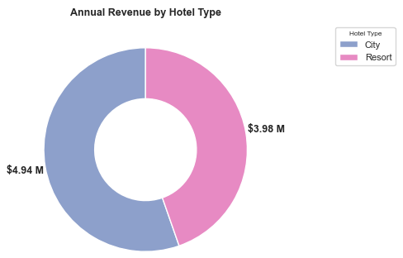
Executive Summary
Data Insights
- A Sneak Peek
Problem Statement
High hotel booking cancellation rates over 35%, and notably higher for city hotel, resulting in an estimated annual revenue loss of over $5.5 M.
Research Questions
What are the primary drivers of cancelation? How effectively can we predict booking cancellation behavior?
Booking Horizon (lead time)
Price Sensitivity
Guest Geography (domestic booking)
Objective
Prepare a comprehensive marketing plan to proactively target guests at risk of churn and prevent revenue loss from cancellations.
Hypothesis
Cancellation likelihood is influenced by factors including booking behavior (e.g., lead time), price sensitivity, deposit policies (e.g., non-refundable), customer type.
Guest Engagement & Experience (room allocation accuracy, special request handling etc.)
Predictive Model with ~90% Accuracy in identifying bookings at high risk of cancellation.
Hotel Type | Booked | Ratio of Total Reservations | Cancelled | Cancellation Rate
City | 79162 | 65% | 33078 | 42%
Resort | 40046 | 35% | 11120 | 28%
Total | 119208 | - | 44198 | 37%

Slide 4
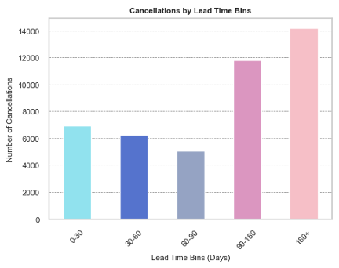
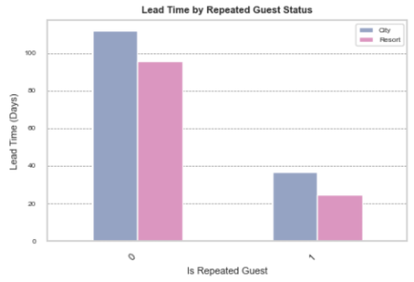
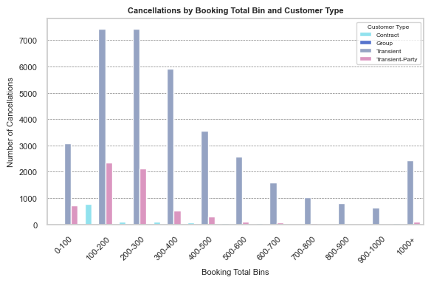
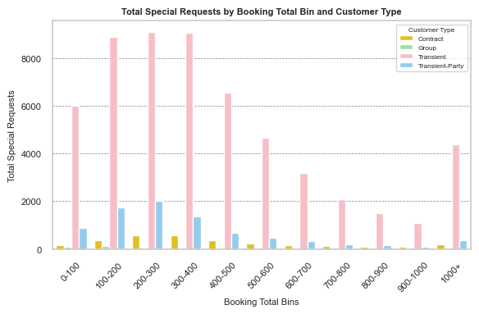
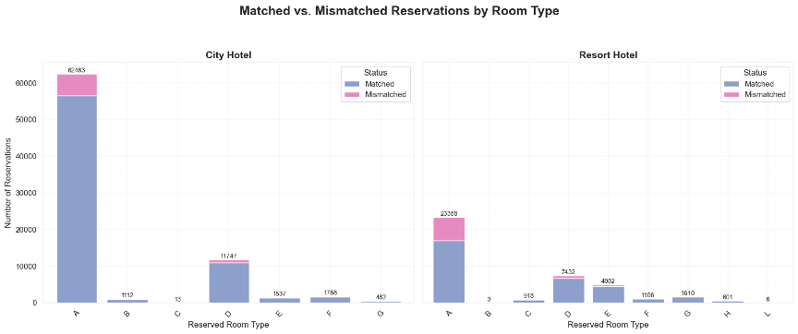
Data Trends and Early Insights
Key Insights
Higher cancellations with > 90 days lead time.
Repeat guests have lower lead time and cancel less.
More cancellations in $100-500 booking total bins – price sensitivity.
Fewer special requests at higher booking total could indicate unmet service expectations.
Special Requests positively correlated with booking total (ADR).
Room mismatch rate 12.4% overall. Maximum mismatches in Room Type A which is also the most booked.

Slide 5
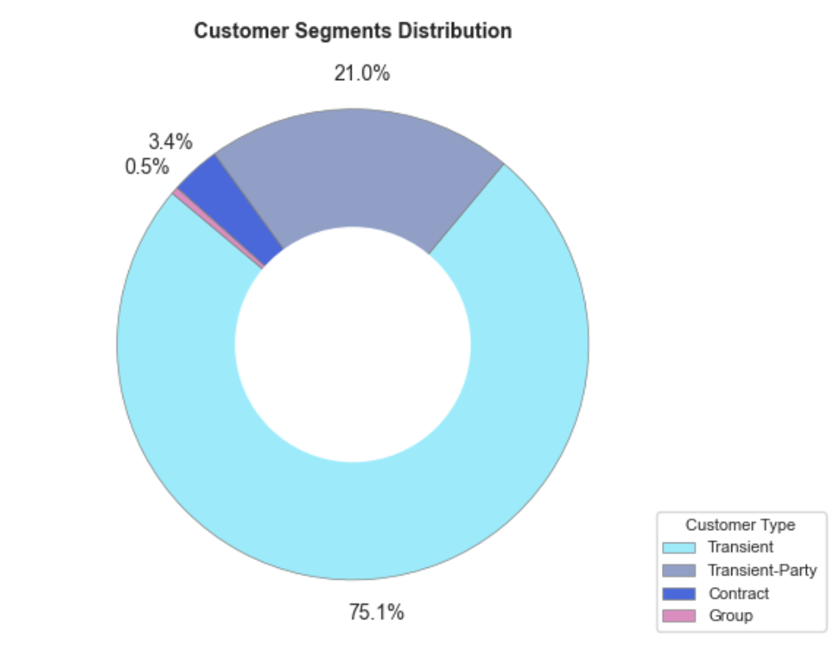
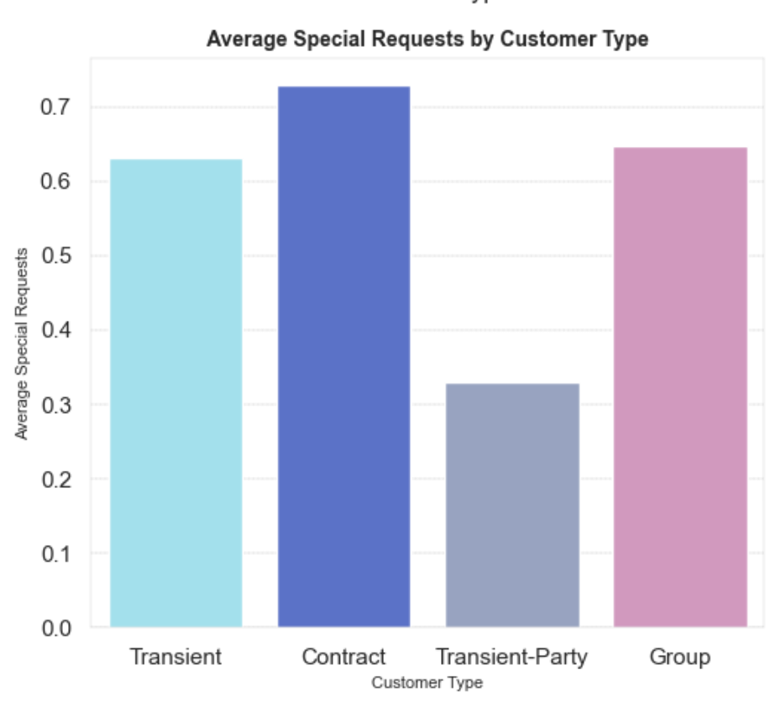
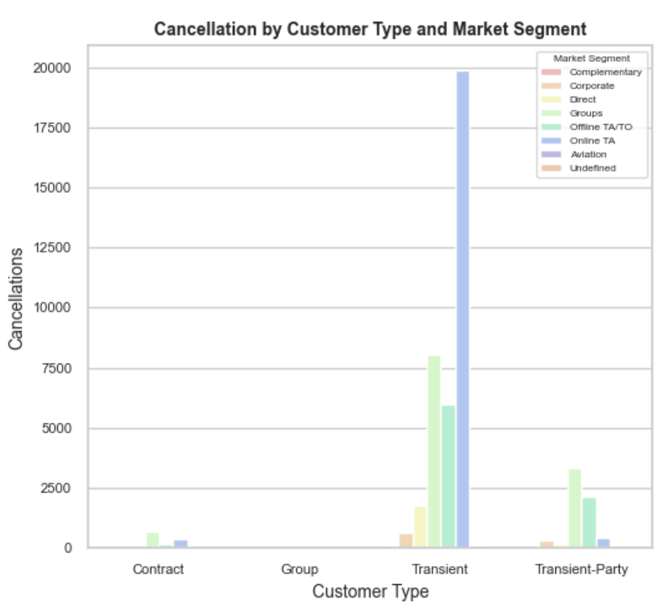
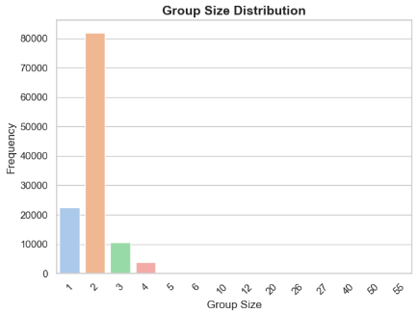
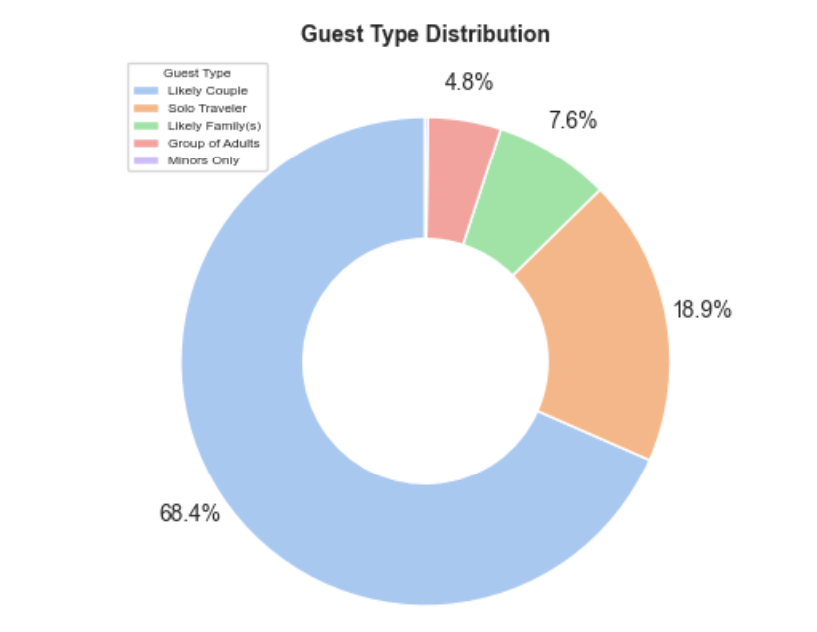
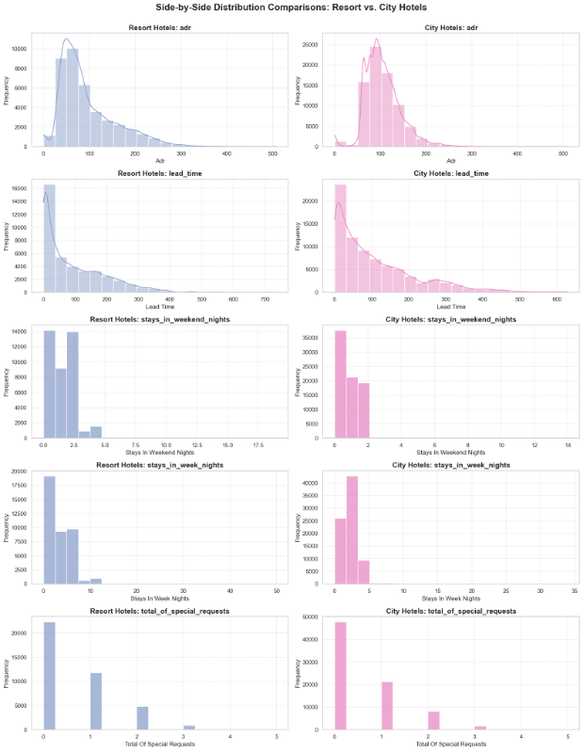
Data Trends and Early Insights Contd.
Key Insights
Majority are Transient customers (75%) followed by Transient-Party.
Transient-Party customers make fewer special requests indicating lower engagement/commitment.
Dominant customer type Transient exhibits most cancellations through Online TA channel.
Group size of 2 (likely couple) represents ~70% of bookings.
Similar data trend between City Hotels and Resorts indicating amenability toward uniform marketing treatment.

Slide 6
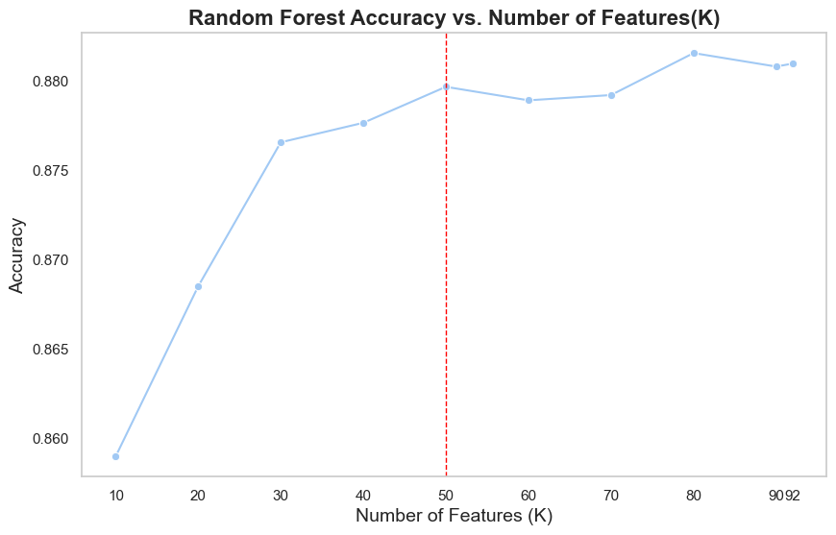
Interpretation of Model Outcome
Interpretation / Insights
Directionality
Department / Action
Lead time
Longer lead times associated with higher cancellations likely due to tentative bookings |  | Marketing can shape promotions for short-lead bookings. Revenue can adjust policies.
Higher booking values may lead to more cancellations due to greater financial commitment or unmet service expectations. |  | Revenue and Finance to work on effective pricing strategies. Marketing can create offers for longer stays.
Domestic guests cancel more often likely due to higher flexibility to change plans. |  | Marketing targets domestic guests with different messaging or policies.
Special requests are associated with lower cancellation probably as it shows stronger guest engagement and commitment |  | Front Office/Guest Relations can encourage/handle special requests preferably through mobile apps.
Past cancellation behavior predicts future cancellations |  | Revenue will make policy adjustments to tackle extreme cases.
Mismatches may cause dissatisfaction, increasing cancellation risk |  | Operations and Front Office must coordinate better to improve room allocation accuracy.
Transient Customers booking through Online TA are likely to cancel. |  | Marketing to design targeted campaigns. Revenue to revisit policies or optimize OTA contracts.
+
Booking Total
(& Total Stay)
+
Country of Origin
+
Accuracy 88%
Special Requests
–
50 features selected based on importance scores
Cancellation History
+
Reduces model complexity, training time, and overfitting risk
Room Mismatches
+
Customer Type & Channel
+

Slide 7





Data Driven Comprehensive Marketing Plan
Problem
Supporting Insight
Action / Incentive
Long lead-times (>90 days) are associated with higher cancellations (tentative bookings)
Repeat guests cancel less and tend to book closer to date of stay
Loyalty program for early-booking guests (>90 days)
Early-bird discounts for non-refundable bookings (>60 days out)
Periodic “reconfirm your stay” nudges via email/SMS.
Double down on City Hotels (higher cancellations, higher revenue), Suggested budget split: City vs. Resort → 60:40.
1
Guests with group size of 2 ("likely couples") - Account for ~70% of reservations. Domestic guests (PRT origin).
High booking totals ($100–$500) may lead to more cancellations, likely due to financial commitment or unmet expectations
Fewer special requests and high mismatch rate (12.4%) indicate weak perceived value
Value-added offers: perks, early check-in, free breakfast
Loyalty points for completion of high-value stays
Upsell commitment: e.g., free spa if not cancelled
2
Transient customers (~75% of total reservations) via Online TA.

Slide 8
Thank you!

Slide 9
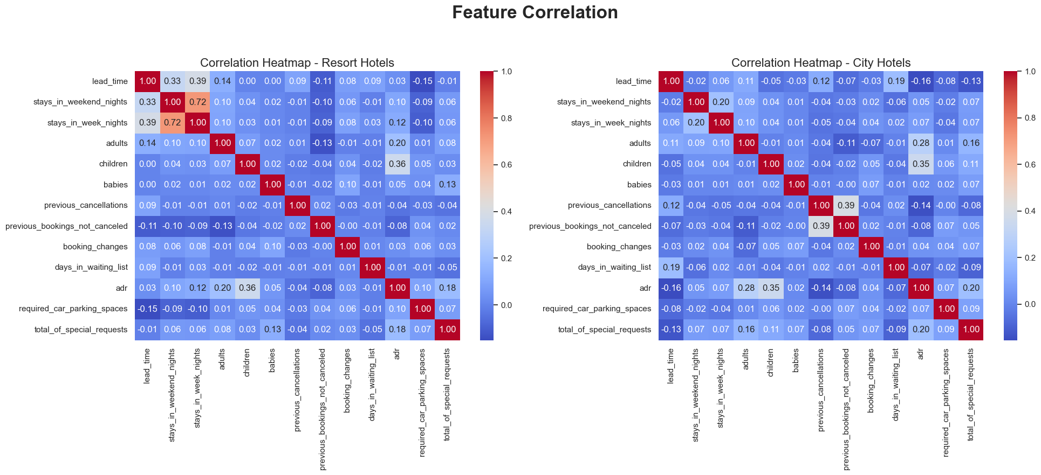
Correlation Analysis
Back

Slide 10
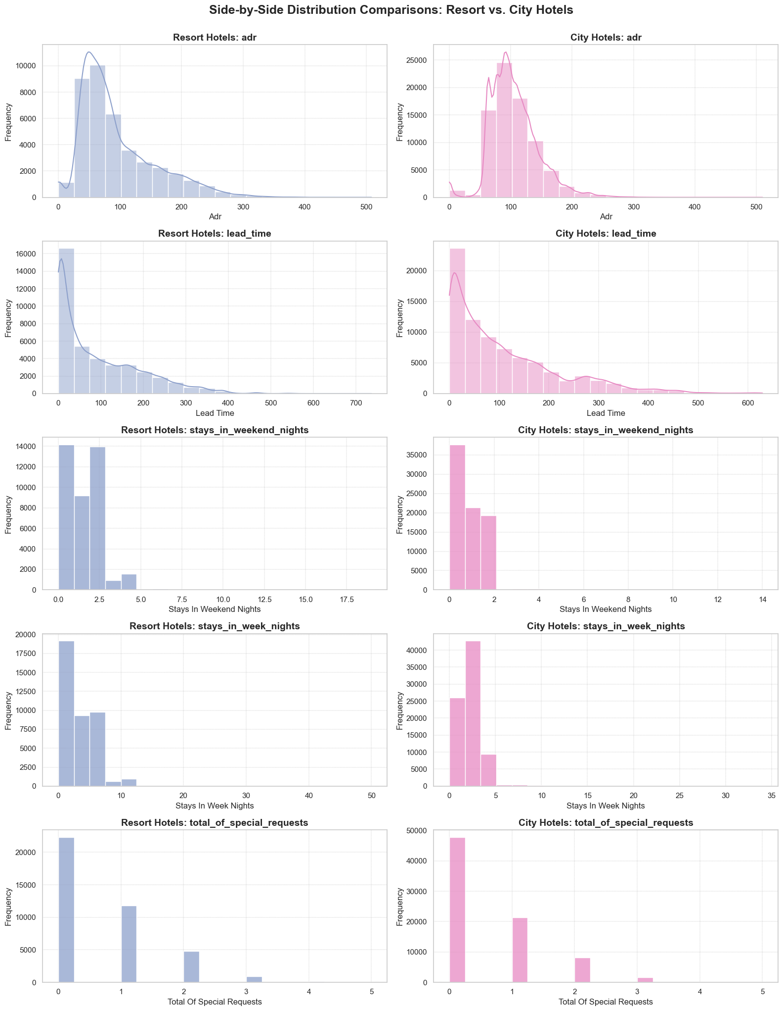
Side-by-Side Distribution Comparisons: Resort vs. City Hotels
Back

Slide 11
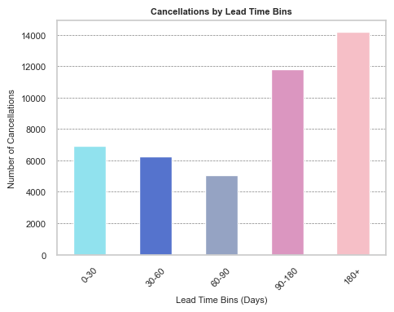
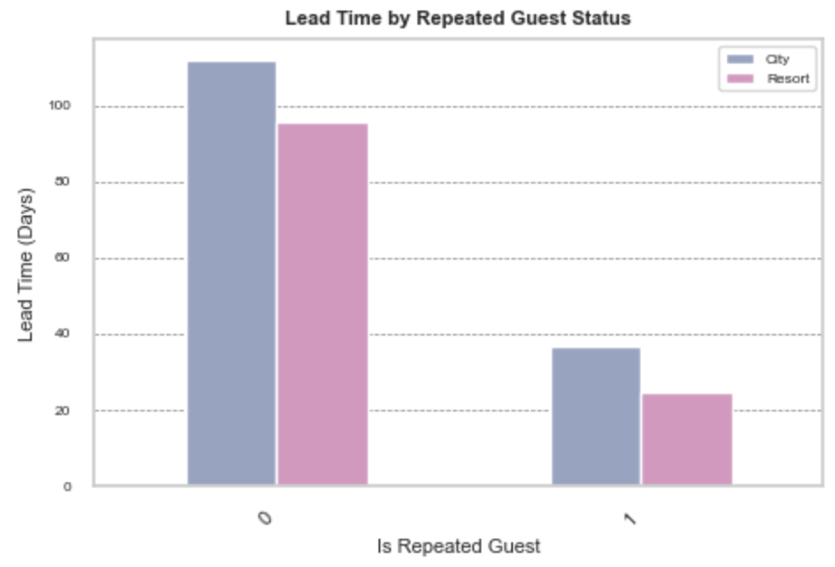

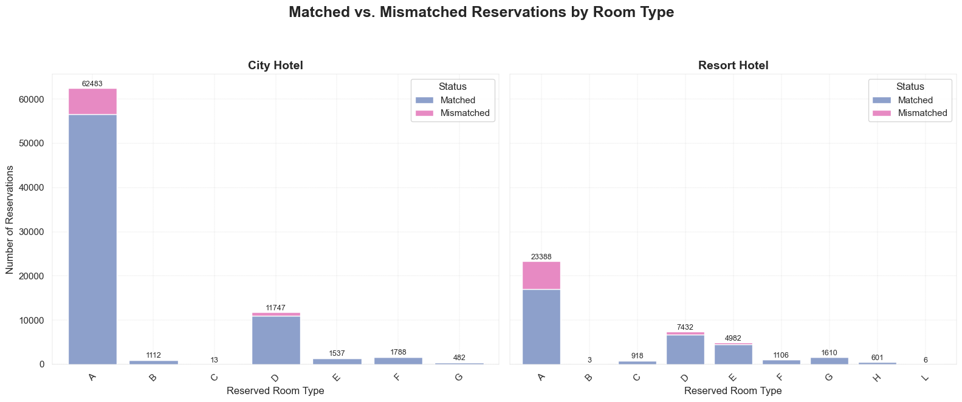

Data Trends and Early Insights

Slide 12
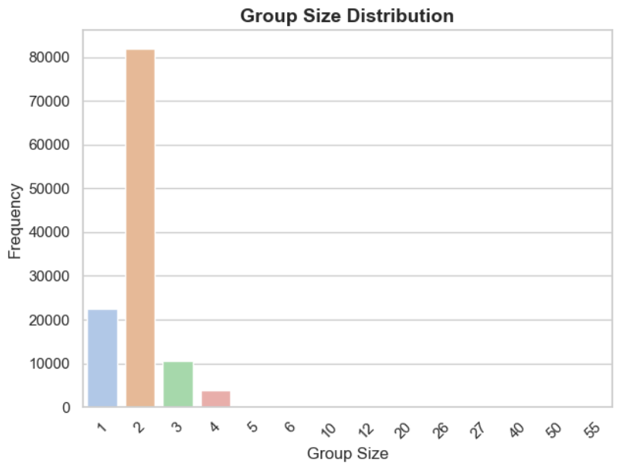
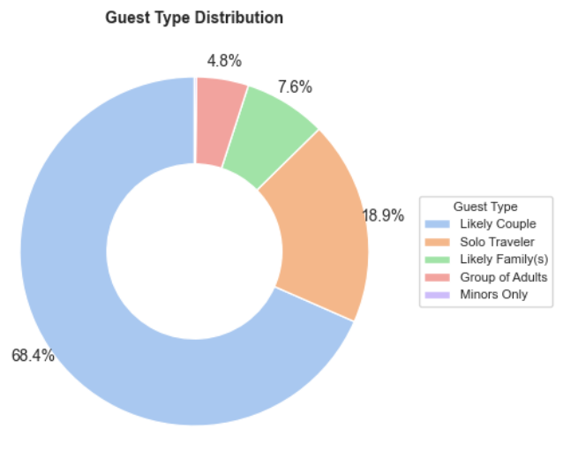
Data Trends and Early Insights Contd.

Slide 13
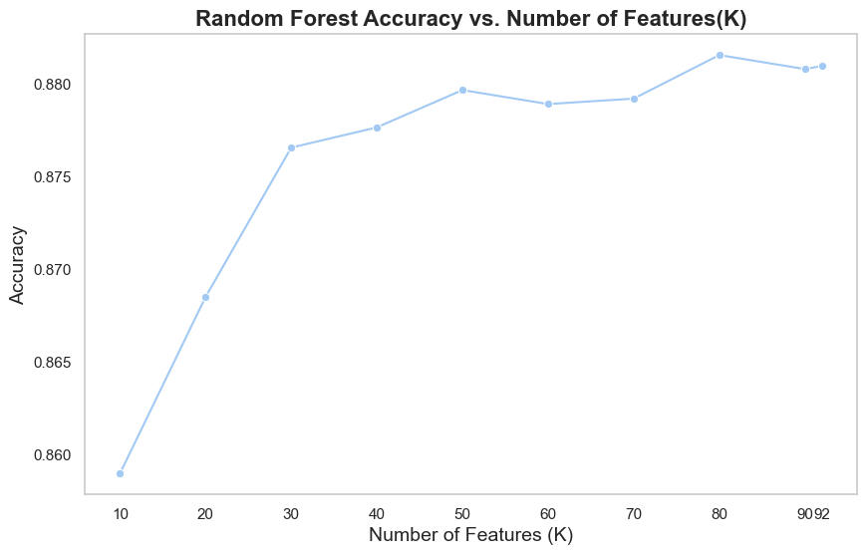
Interpreting Model Outcomes
Lead Time: Longer lead times are the most significant predictor of cancellations.
1
Efficient Feature Selection
The top 50 features were selected based on importance scores, achieving nearly the same accuracy (~88%) as the complete feature set. This reduces model complexity, training time, and overfitting risk while simplifying interpretation.
2
Revenue Metrics: Higher total revenue bookings are more prone to cancellations, reflecting financial sensitivity.
Model Selection
The final Random Forest model's performance was assessed using a confusion matrix and classification report, demonstrating strong precision (0.89 for non-cancellations, 0.88 for cancellations) and recall (0.94 for non-cancellations, 0.81 for cancellations).
Country of Origin: Guests from Portugal (domestic bookings) are more likely to cancel.
3
Special Requests: Fewer special requests indicate a higher likelihood of cancellation.
4
Total Stay Duration: Longer stays are slightly more prone to cancellations, likely due to higher financial and logistical commitments
5
Cancellation History: Past cancellations are a strong predictor of future cancellations.
6
Room Mismatches: Operational inconsistencies, such as room mismatches, increase cancellation probabilities.
7

Slide 14
Marketing Plan
Model Driver | Actionable by Retention Team | Retention Category | Key Insight | Action / Incentive Plan
Lead Time | Yes | Booking Commitment | Bookings >90 days have a much higher cancellation risk. | Early Engagement: Send personalized reminder emails/messages to long-lead-time bookers. Example: “Hi, your stay is coming up! Enjoy a free breakfast if you confirm your booking now.” Targeted Offers for Local (PRT) Guests: Lauch exclusive local offers or experiences (e.g., discounted spa, dining, or event tickets) for Portuguese guests with long lead times to increase perceived value and reduce speculative bookings. "Exclusive for our Portuguese guests: Confirm your booking now and get 20% off at our restaurant during your stay!" Flexible Modification, Not Cancellation: For non-refundable bookings, make it easy for guests to modify dates or details instead of canceling, and clearly communicate this flexibility in all pre-stay communications. Post-Stay Engagement: Follow up with personalized thank-you emails and exclusive offers, encouraging repeat bookings.
Total Revenue ($100–$500) | Yes | Price Sensitivity | Most cancellations are in the $100–$500 revenue bin (price-sensitive). | Value-Added Offers: Bundle perks (e.g., free parking, breakfast) for bookings in this range to increase perceived value and reduce cancellations. Example: “Book now for $120/night and get complimentary breakfast and parking!”
Room Mismatch | Yes | Operational Excellence | Incorrect room assignments increase cancellations. | Improve room assignment accuracy to reduce cancellations due to dissatisfaction; offer compensation or upgrades when mismatches occur. Optimize inventory allocation to ensure Room Type A availability matches demand based on the historical demand. Staff training and process review to minimize assignment errors. Dynamic pricing for Room Type A to manage demand and encourage bookings in other categories by offering discounts.
Special Request | Yes | Guest Engagement | Fewer special requests at high lead times; more requests = lower cancellations | Drive Engagement Through Special Requests Encourage guests to make special requests or select add-ons during booking, increasing engagement. Example: “Customize your stay with special amenities- add now and save 10%!”
Customer Type/ Market Segment | Yes | Customer Segmentation | High cancellation rate, low loyalty, mostly book through TA/TO | Launch a “Book Direct & Save” campaign with instant perks (e.g., complimentary breakfast, flexible check-in/out). Partner with OTAs to offer exclusive, non-refundable deals or loyalty points for completed stays. ( Needs to be revisited )
Group Size of 2 | Yes | Guest Engagement | Group size of 2 most common in booking | Couple Packages: Create special couple packages with romantic add-ons to increase booking commitment. Example: “Couple’s Getaway: Book for two and receive a complimentary spa voucher!”
Notes:
Lead Time and relevant metrics.
Lead time bins 90-180 days and 180+ days have the highest cancellation counts.
Over 50% of these bookings are from Portugal (PRT) local customers.
More than 90% are booked via Travel Agents (TA) / Tour Operators (TO).
Over 90% are non-repeat customers.
No effective special requests indicating lower engagement or commitment.
Customer type is predominantly Transient.
Deposit types are mostly non-refundable and non-deposit, with a slightly higher proportion of non-deposit in 90-180 days.
Marketing plan
1. Increase Booking Commitment through Deposit Policies
Introduce or promote refundable deposit options for long lead-time bookings to encourage commitment.
For non-refundable or no-deposit bookings, offer incentives such as discounts or loyalty points for converting to refundable deposits.
Clearly communicate deposit policies and benefits to reduce cancellations driven by low commitment.
2. Enhance Customer Engagement and Personalization
Since special requests correlate with lower cancellations, encourage guests to make special requests:
Proactively offer add-ons or personalized options (e.g., room upgrades, late check-outs, special amenities) via TA/TO channels.
Send personalized emails or messages highlighting these options post-booking.
3. Strengthen Relationships with Travel Agents and Tour Operators
Collaborate with TA/TO partners to:
Educate them on cancellation risks and benefits of promoting refundable deposits or special requests.
Provide incentives for agents who book customers with higher engagement levels.
Share cancellation prediction insights to help agents identify high-risk bookings early.
4. Target Non-Repeat Customers with Loyalty Programs
Launch loyalty or referral programs to convert non-repeat customers into repeat guests.
Offer early-bird specials or exclusive benefits for returning customers to reduce cancellations.
Use remarketing campaigns focused on previous bookers who cancelled to understand and address their concerns.
5. Tailored Communication and Reminders
Send timely reminders and value-adding content to guests with long lead times:
Highlight upcoming events, hotel improvements, or exclusive offers.
Provide flexible modification options to reduce cancellations due to changing plans.

Slide 15
Marketing Plan
Model Driver | Actionable by Retention Team | Retention Category | Key Insight | Action / Incentive Plan
Lead Time | Yes | Booking Commitment | Bookings >90 days have a much higher cancellation risk. | Early Engagement: Send personalized reminder emails/messages to long-lead-time bookers. Example: “Hi, your stay is coming up! Enjoy a free breakfast if you confirm your booking now.” Targeted Offers for Local (PRT) Guests: Lauch exclusive local offers or experiences (e.g., discounted spa, dining, or event tickets) for Portuguese guests with long lead times to increase perceived value and reduce speculative bookings. "Exclusive for our Portuguese guests: Confirm your booking now and get 20% off at our restaurant during your stay!" Flexible Modification, Not Cancellation: For non-refundable bookings, make it easy for guests to modify dates or details instead of canceling, and clearly communicate this flexibility in all pre-stay communications. Post-Stay Engagement: Follow up with personalized thank-you emails and exclusive offers, encouraging repeat bookings.
Total Revenue ($100–$500) | Yes | Price Sensitivity | Most cancellations are in the $100–$500 revenue bin (price-sensitive). | Value-Added Offers: Bundle perks (e.g., free parking, breakfast) for bookings in this range to increase perceived value and reduce cancellations. Example: “Book now for $120/night and get complimentary breakfast and parking!”
Room Mismatch | Yes | Operational Excellence | Incorrect room assignments increase cancellations. | Improve room assignment accuracy to reduce cancellations due to dissatisfaction; offer compensation or upgrades when mismatches occur. Optimize inventory allocation to ensure Room Type A availability matches demand based on the historical demand. Dynamic pricing for Room Type A to manage demand and encourage bookings in other categories by offering discounts.
Group Size of 2 | Yes | Guest Engagement | Group size of 2 most common in booking | Couple Packages: Create special couple packages with romantic add-ons to increase booking commitment. Example: “Couple’s Getaway: Book for two and receive a complimentary spa voucher!”
Notes:
Lead Time and relevant metrics.
Lead time bins 90-180 days and 180+ days have the highest cancellation counts.
Over 50% of these bookings are from Portugal (PRT) local customers.
More than 90% are booked via Travel Agents (TA) / Tour Operators (TO).
Over 90% are non-repeat customers.
No effective special requests indicating lower engagement or commitment.
Customer type is predominantly Transient.
Deposit types are mostly non-refundable and non-deposit, with a slightly higher proportion of non-deposit in 90-180 days.
Marketing plan
1. Increase Booking Commitment through Deposit Policies
Introduce or promote refundable deposit options for long lead-time bookings to encourage commitment.
For non-refundable or no-deposit bookings, offer incentives such as discounts or loyalty points for converting to refundable deposits.
Clearly communicate deposit policies and benefits to reduce cancellations driven by low commitment.
2. Enhance Customer Engagement and Personalization
Since special requests correlate with lower cancellations, encourage guests to make special requests:
Proactively offer add-ons or personalized options (e.g., room upgrades, late check-outs, special amenities) via TA/TO channels.
Send personalized emails or messages highlighting these options post-booking.
3. Strengthen Relationships with Travel Agents and Tour Operators
Collaborate with TA/TO partners to:
Educate them on cancellation risks and benefits of promoting refundable deposits or special requests.
Provide incentives for agents who book customers with higher engagement levels.
Share cancellation prediction insights to help agents identify high-risk bookings early.
4. Target Non-Repeat Customers with Loyalty Programs
Launch loyalty or referral programs to convert non-repeat customers into repeat guests.
Offer early-bird specials or exclusive benefits for returning customers to reduce cancellations.
Use remarketing campaigns focused on previous bookers who cancelled to understand and address their concerns.
5. Tailored Communication and Reminders
Send timely reminders and value-adding content to guests with long lead times:
Highlight upcoming events, hotel improvements, or exclusive offers.
Provide flexible modification options to reduce cancellations due to changing plans.

Slide 16
Marketing Plan
01
02
03

